Slide 1
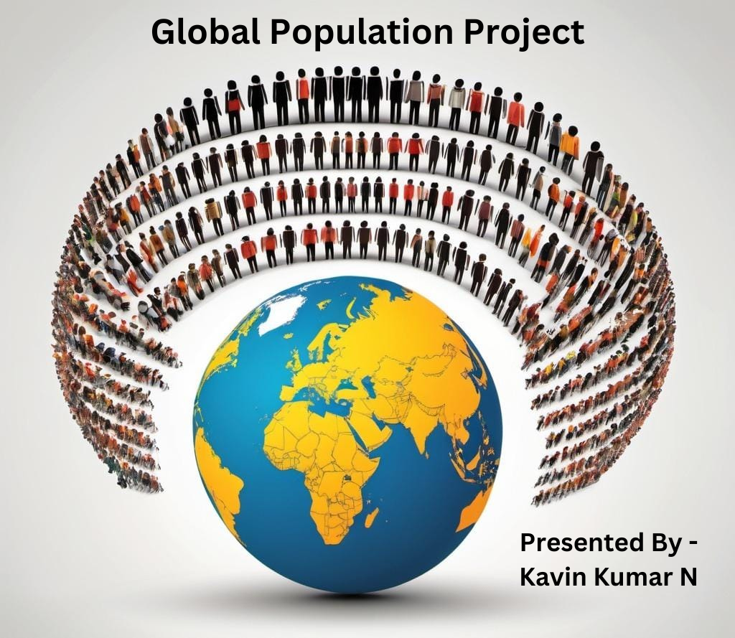

Slide 2
Project Overview
Briefly introduce the purpose of the dashboard:
This dashboard provides an interactive view of global population statistics, land area, growth rate, and world population percentage by country. It allows users to explore trends over time and compare metrics between countries.

Slide 3
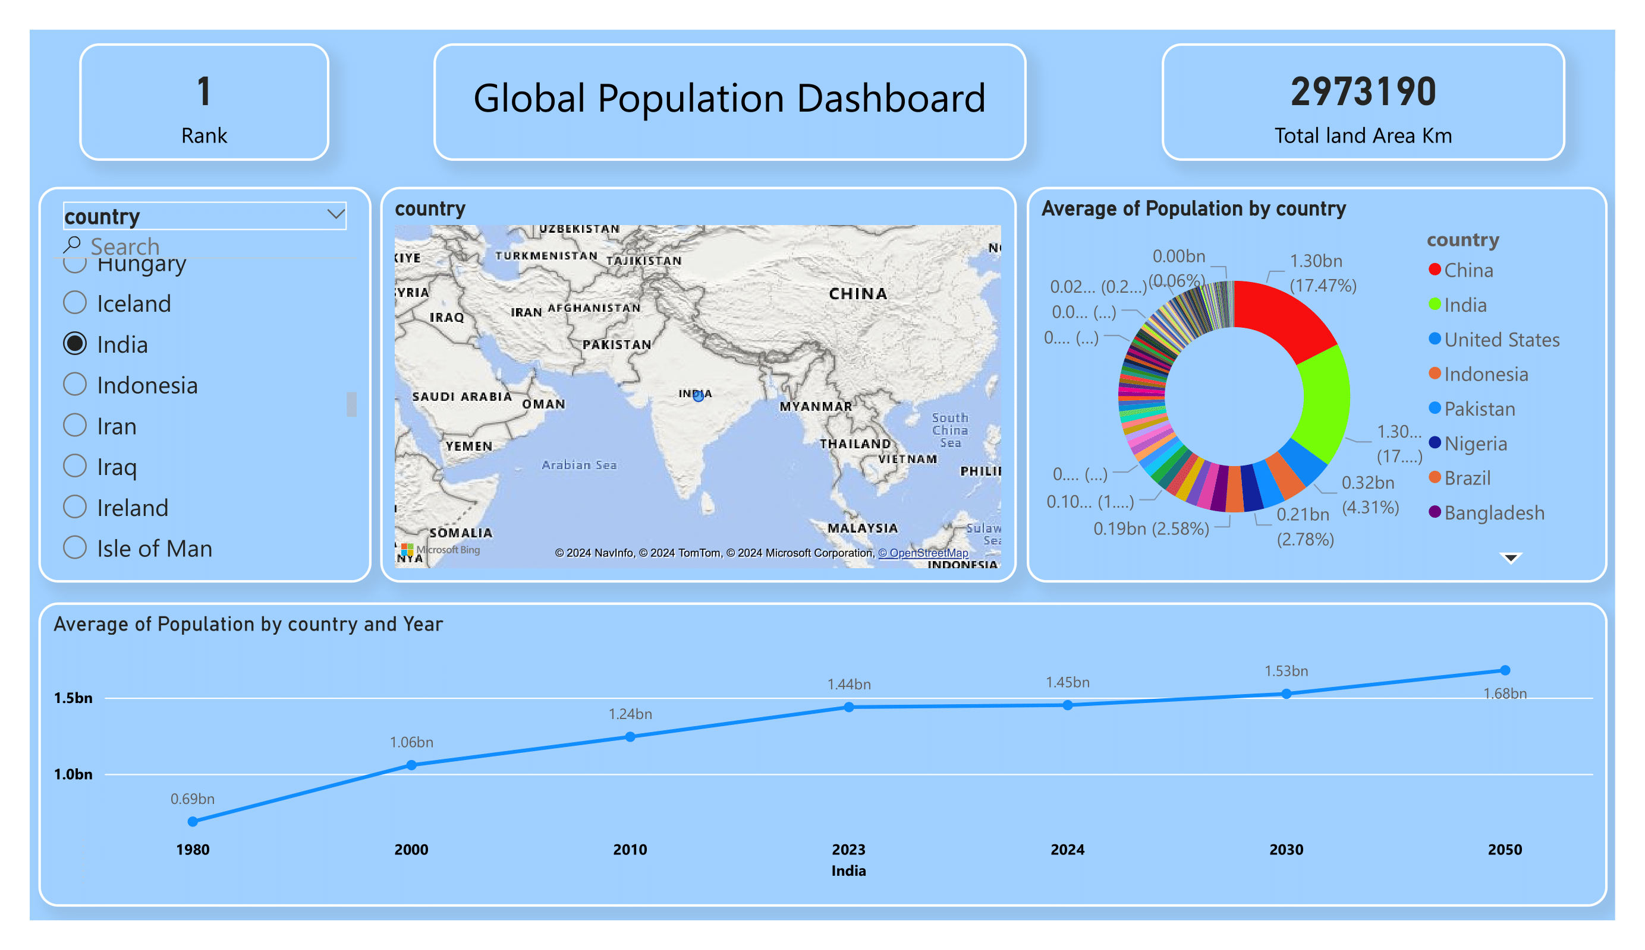
Global Population Dashboard Sample

Slide 4
Dashboard Overview
This is a snapshot of the entire Global Population Dashboard:
Map: Shows the geographic distribution of countries, allowing for easy location of each nation’s statistics.
Key Metrics: Total land area and rank by population are shown at the top.
Population by Year: The trend line at the bottom provides an interactive timeline of population growth for each selected country.

Slide 5
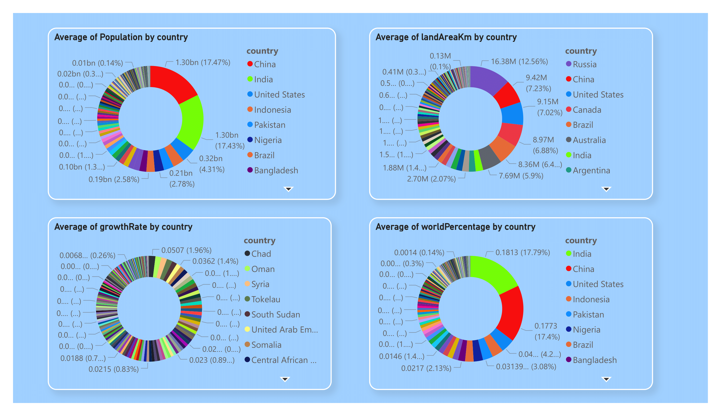
Population Distribution by Country

Slide 6
Distribution by Country
The charts depict the distribution of key metrics by Country:
Population: China and India lead with 17.47% and 17.43% of the global population, respectively.
Land Area: Russia has the largest land area, covering 12.56% of global land.
Growth Rate: Chad, Oman, and Syria show high growth rates, while many other countries have much lower rates.
World Population Percentage: India and China account for over 34% of the world’s population.

Slide 7
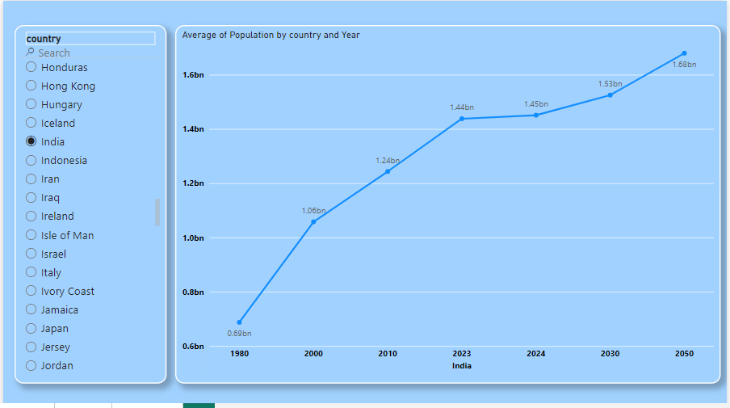
Population Trends Over Time

Slide 8
Population Trends Over Time
The line graph illustrates the population growth trends for selected countries from 1980 to 2050.
India’s population has grown steadily, with projections indicating continued growth through 2050.
Other countries display varying growth trajectories, with some stabilizing over time.
Key Milestones: India’s population reaches 1.45 billion in 2024 and is projected to reach 1.68 billion by 2050.

Slide 9
Key Insights and Takeaways
Summarize the main findings:
China and India are the most populous countries, accounting for over one-third of the world’s population.
Countries like Chad and Oman exhibit higher population growth rates, suggesting rapid changes in demographic composition.
Russia’s large land area contrasts sharply with its lower population, highlighting geographic and demographic variances across regions.

Slide 10
Conclusions:
This dashboard provides a clear view of global population dynamics, allowing for further research and policy planning.
Thank you for your attention.
Name: Kavin Kumar N
Email ID: kavinkumar5412@gmail.com

